Slide 1
Capstone Final Project
Machine Learning Fundamentals
Eduardo Guerrero
12/11/2018

Slide 2
Table of Contents
Exploration of the Dataset
Question(s) to answer
Augmenting the Dataset
Regression Approaches
Classification Approaches
Conclusions / Next Step

Slide 3
Exploration of the Dataset
age | body_type | diet | drinks | drugs | education
29 | skinny | mostly vegetarian | socially | never | graduated from college/university
19 | fit |  |  | never
35 | average | anything | rarely | never | college/university
21 | fit | anything | socially | never | graduated from college/university
This dataset contains information about the app to find love.
This dataset Will transformed add new columns for analysis.
The approach Will use are Multiple Linear Regression and classification algorithms
essay0 | essay1 | essay2 | essay3 | essay4 | essay5 | essay6 | essay7 | essay8 | essay9
ethnicity | height | income | job | last_online | location | offspring | orientation | pets | religion | sex | sign | smokes | speaks | status
white | 71 | -1 | artistic / musical / writer | 2012-06-26-15-18 | san francisco, california |  | gay |  |  | m |  | no | english | single
white | 73 | -1 |  | 2012-06-08-20-46 | san francisco, california |  | straight |  |  | m |  |  | english | single
white | 71 | -1 | science / tech / engineering | 2012-05-01-10-55 | san francisco, california |  | straight | likes dogs |  | m |  | no | english | single

Slide 4
Question(s) to answer
1, What relation are between age and essay_len
For answer this questions, we use Linear Regression

Slide 5
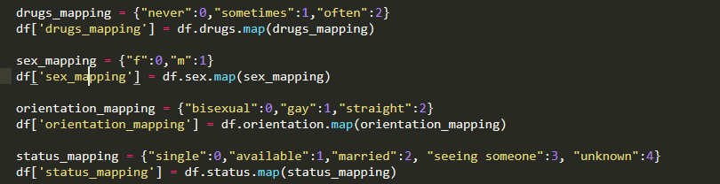
Augmenting the dataset
For the approach Multiple Linear Regression i need add this columns:

Slide 6
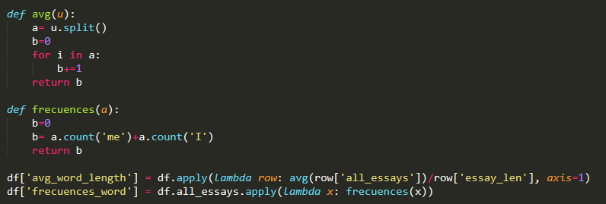
Augmenting the dataset
For créate the columns avg_word_length and frecuences_Word i created two functions that shows below.

Slide 7
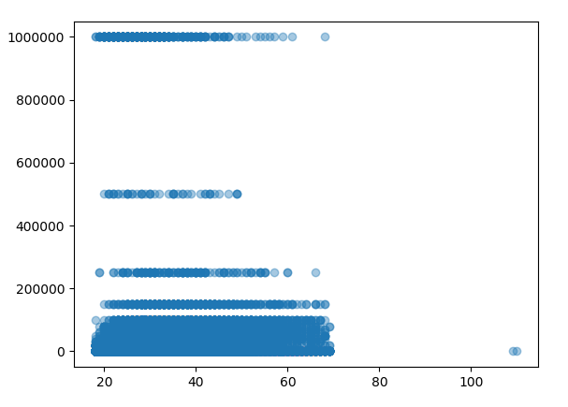
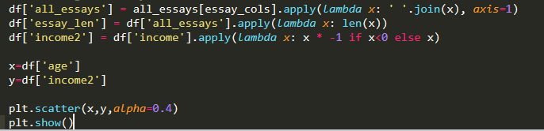
Explorer the data

Slide 8
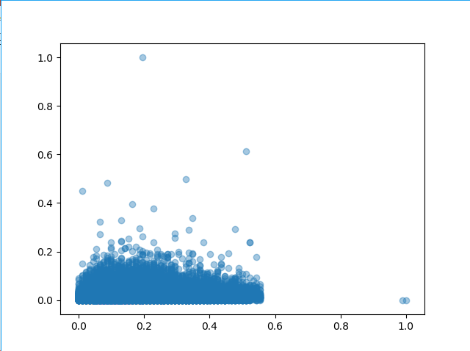
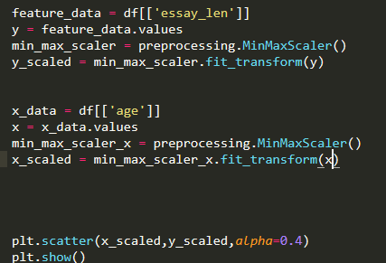
Linear Regression Model

Slide 9
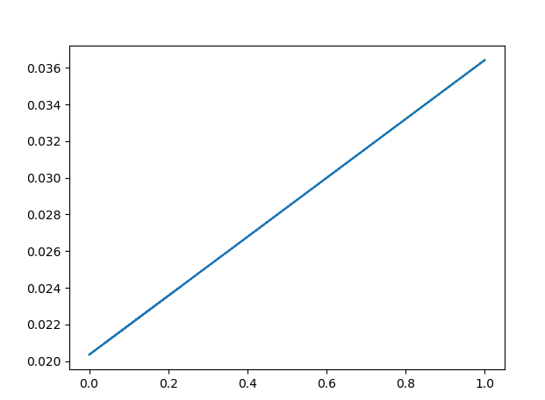
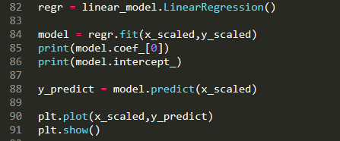
Linear Regression Model
With the age grow, income grow

